Slide 1

Data-”Driven” Insights
EHS&S Dashboards & Tools
EHS&S Systems and Tools (S&T)
February 17, 2022
Notes:
Megha to open the slides and the dashboards (have them ready))
Alex to present out for EMEA slides

Slide 2
Agenda
Who, What, and Why
Gazing into the past, present, and future
Intro into Storytelling
Showcase sessions
Q&A
Reflections

Slide 3











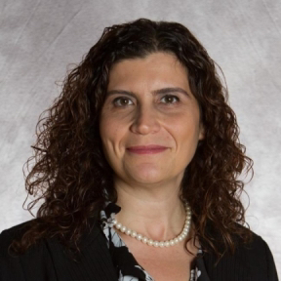
EHSS Data Engineering Team
Why we are here
We produce data that feeds data-driven decisions and workflows for EHSS and Tesla as a whole
Alex Matei
Data Engineer, Health, Safety & Security
Anthony Splendor
Data Engineer, Environmental
Bradley Heinrich
Business & Data Analyst
How we do it
Purposeful drive to innovate fast
Building strong partnerships and continuous learning
Likhitha Bheemanath
Data Engineer, Health & Safety
Megha Gupta
Data Engineer, Health & Safety
Rob Mccafferty
Sr. Director QA
Our products and services address business needs using data
What our products and services do
Elyssa Smith
Manager, QA
Brian Ha
Intern
Iris Chien
Intern
Anna Caron
Intern
Benjie Carpena
Data Engineering Lead
Sahika Korkmaz
Senior Manager
Notes:
Benjie

Slide 4





EHSS Data Engineering Team
There was one EHS Data Engineer…
Q4
2020
Why we are here
Kicked off MyEHS req. gathering
EHSS Data
Q1
2021
We produce data that feeds data-driven decisions and workflows for EHSS and Tesla as a whole
Integration with Security
Monthly Frozen Process
Confluence page & JIRA
1st F2F
Q2
2021
Alex Matei
Data Engineer, Health, Safety & Security
Anthony Splendor
Data Engineer, Environmental
Bradley Heinrich
Business & Data Analyst
Enhance and rework current portfolio
How we do it
Purposeful drive to innovate fast
Building strong partnerships and continuous learning
Q3
2021
Likhitha Bheemanath
Data Engineer, Health & Safety
Internal Audit
2nd F2F
Megha Gupta
Data Engineer, Health & Safety
Field Mapping & Gensuite Tables
MyEHS Deployment & Training
Frozen Numbers Saga
Pandemic Series
PwC Audit
Q4
2021
Rob Mccafferty
Sr. Director QA
Survived 2021 OSHA Logs
MyEHS Module Development
Leveling up our Data Engineering maturity
Q1
2022
Our products and services address business needs using data
What our products and services do
Brian Ha
Intern
Iris Chien
Intern
Anna Caron
Intern
Fine-tune products and services to deliver innovative solutions
Benjie Carpena
Data Engineering Lead

Slide 5
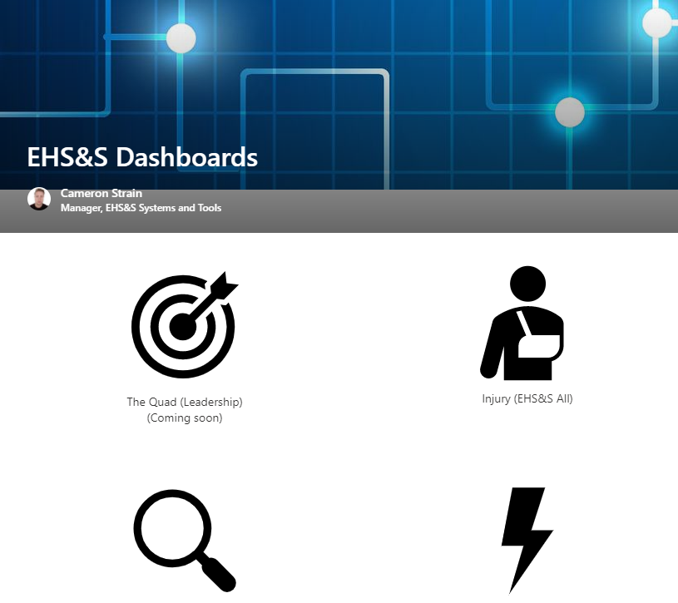

What to Expect
Learning session for major EHSS dashboards – new & old!
What are some decisions you make as an EHS professional and how does data affect you and your stakeholders?

Slide 6
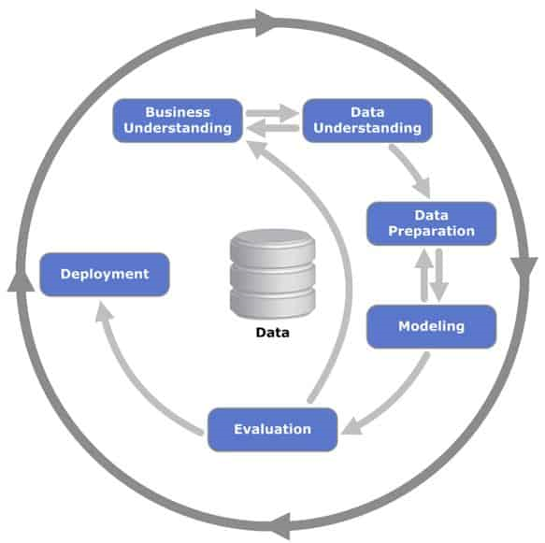

Dashboard Basics Intro.
Dashboards combine multiple metrics and data visuals (charts & graphs) and visualize them in a centralized view
You can customize them to your scope through filters
Meant to solve a business problem and serve as a catalyst to informed action
CRISP-DM
Cross-Industry Standard Approach to Data Mining

Slide 7
Let’s talk data
Dashboards and Data Products

Slide 8
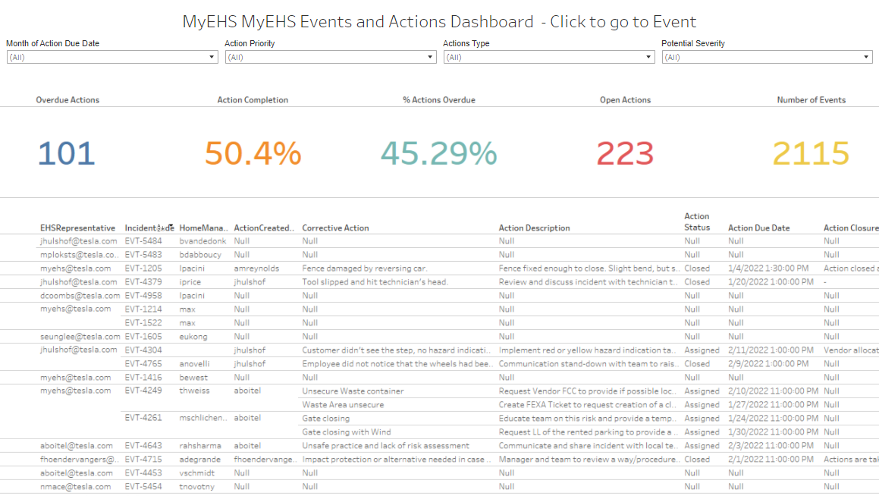
Actions Dashboard
What: MyEHS events and actions data
Event level determination
Why: Manage & trend actions from events
Where: go.tesla.com/actionsdashboard
S&T Contact: Likhitha Bheemanath
QRG Link: Actions QRG

Slide 9
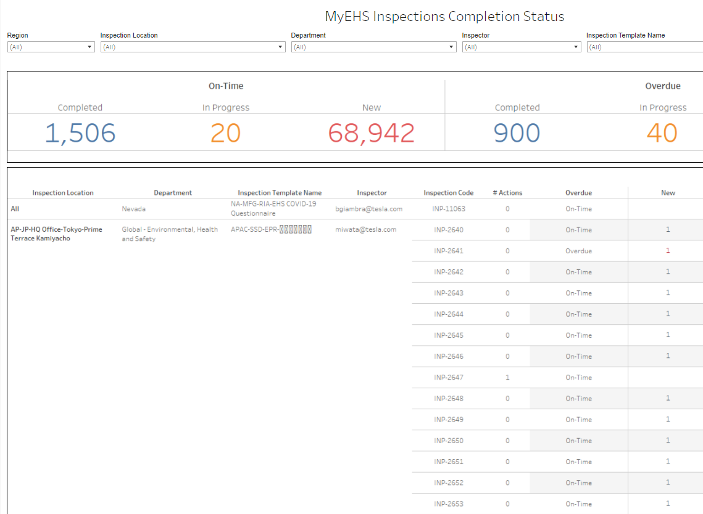
Inspections Dashboard
What: MyEHS & Historic Gensuite Inspections Data
MyEHS – Inspection Status
Historic Gensuite – Inspection Scorecard
Why: Manage & trend inspections
Where: go.tesla.com/inspections
Historic Gensuite Data
S&T Contact: Anthony Splendor
QRG Link: Inspections QRG

Slide 10
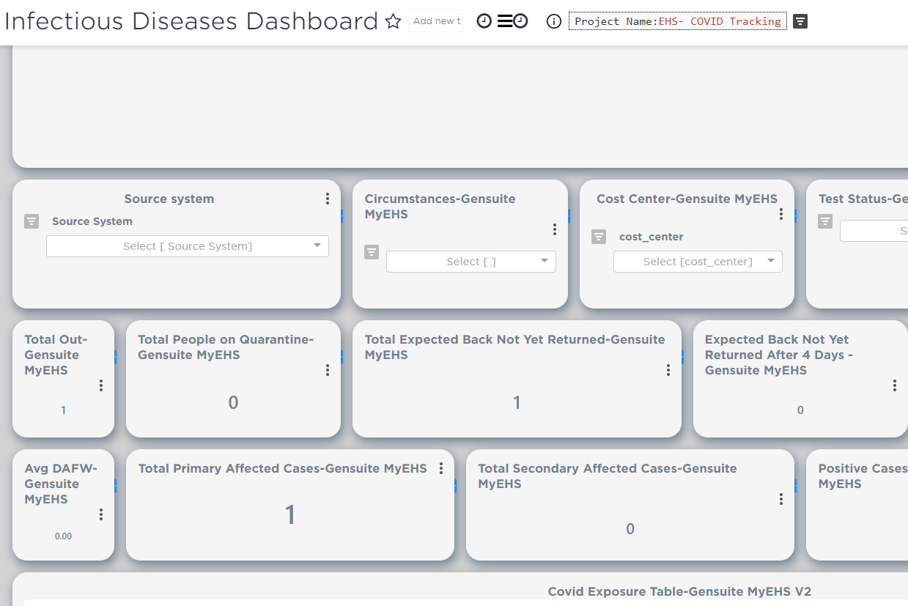
Infectious Disease Dashboard
What: COVID data
Why: Manage pandemic-related cases and quarantined employees
Where: go.tesla.com/infectiousdisease
S&T Contact: Megha Gupta
QRG Link: Infectious Disease QRG

Slide 11
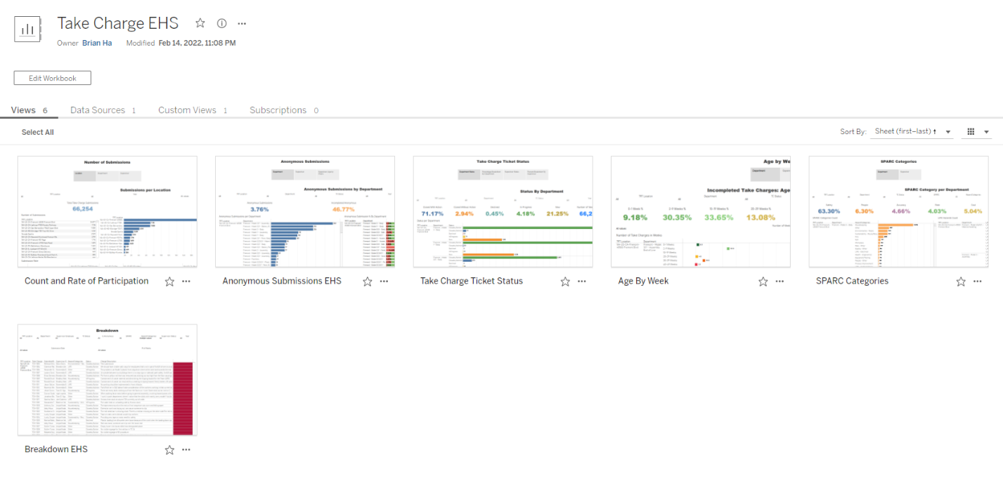
Take Charge Dashboard
What: MyEHS Take Charge data and Headcount
Why: Track and trend Take Charge submissions with a variety of metrics
Where: go.tesla.com/tcehs
S&T Contact: Brian Ha, Likhitha Bheemanath
QRG Link: Take Charge QRG

Slide 12
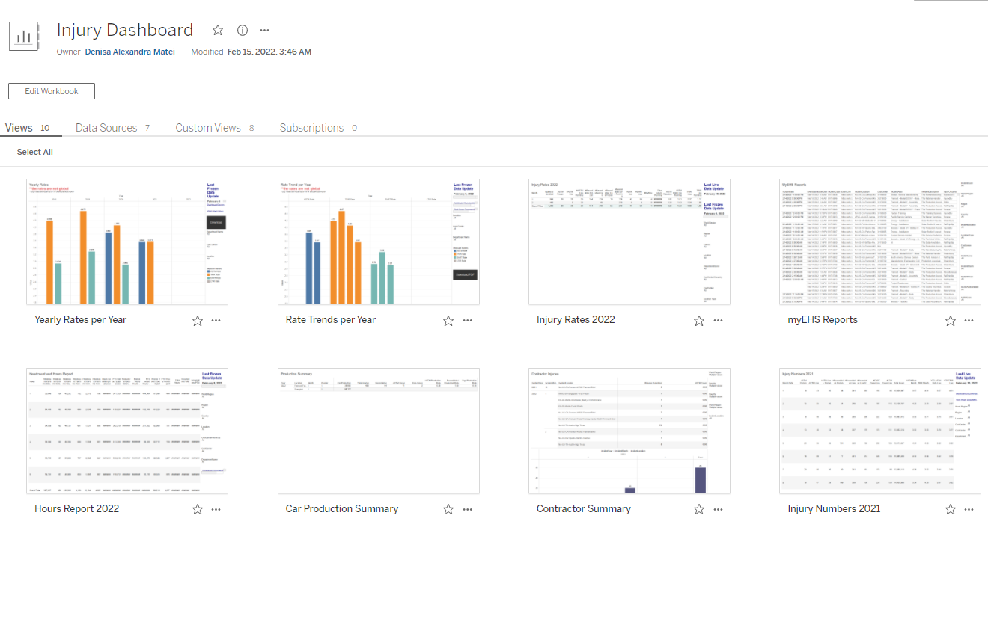
Injury Dashboard
What: Injury/Illness (I&I), Headcount, Workhours Data
Why: Track injury rates and get I&I daily reports
Where: https://go.tesla.com/injury
S&T Contact: Alex Matei
QRG Link: Injury QRG

Slide 13
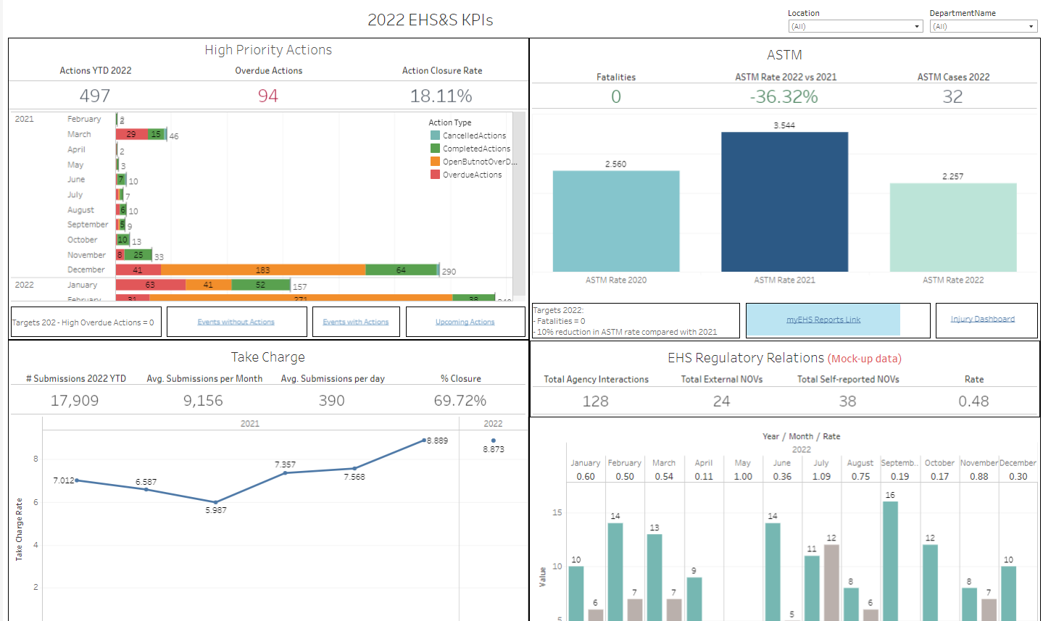
KPI Dashboard
What: Actions, Take Charge, ASTM, & Regulatory Interactions Data
Why: One-stop shop for global EHS&S KPIs
Source of truth with operational leaders!
Where: https://go.tesla.com/quad
S&T Contact: Likhitha Bheemanath,
Alex Matei, Anthony Splendor

Slide 14
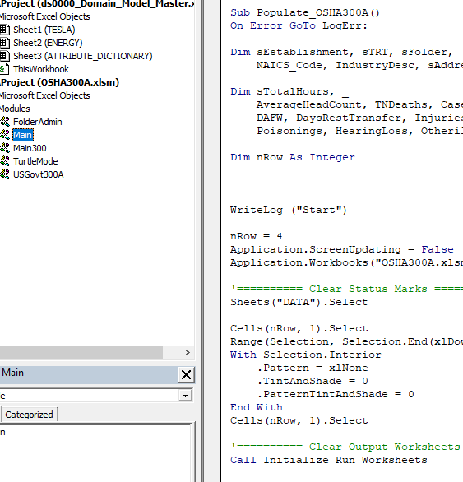

OSHA Logs
OSHA 300 & 300A for over 430 locations
Can now generate logs for hundreds of sites in minutes
Being built into the new tool!

Slide 15
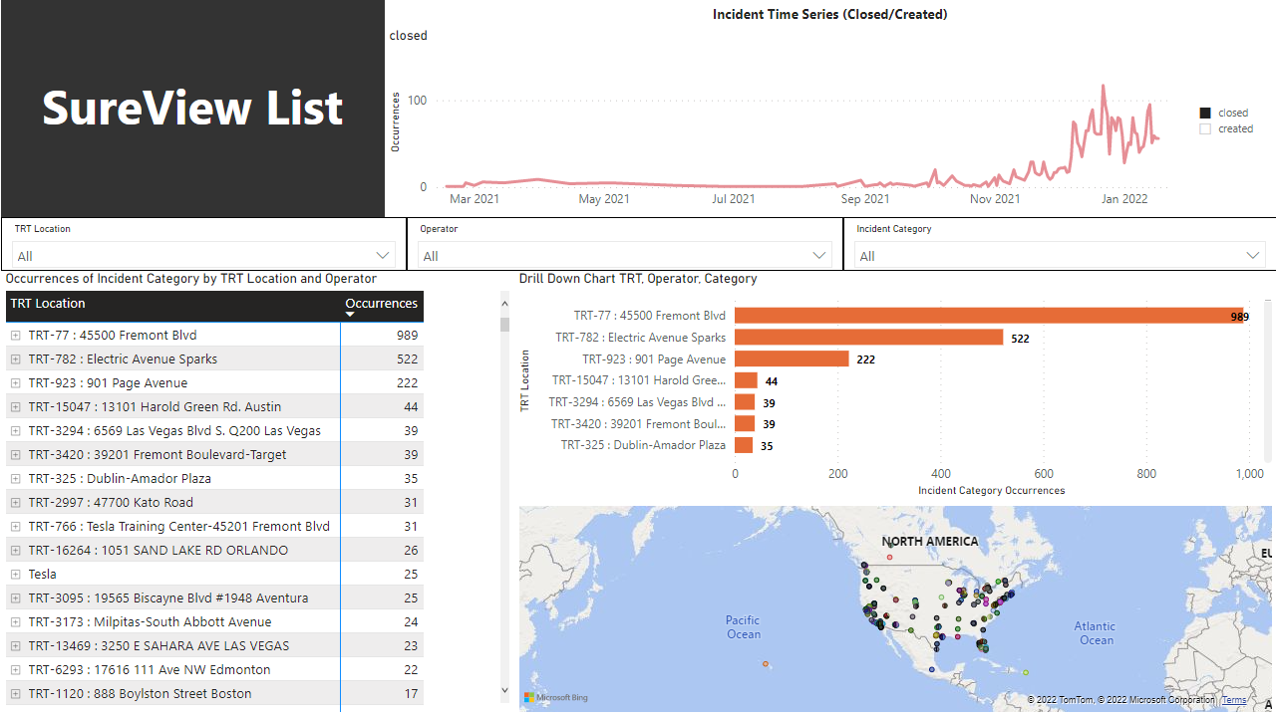
Security Incident Dashboard
What: Security incidents data (SIMS & Sureview)
Why: Track & manage security incidents, resource deployment, mitigate risk, and facilitate operational decisions
Where: go.tesla.com/securitylistvisual
S&T Contact: Alex Matei, Brian Ha
QRG Link: Coming Soon

Slide 16
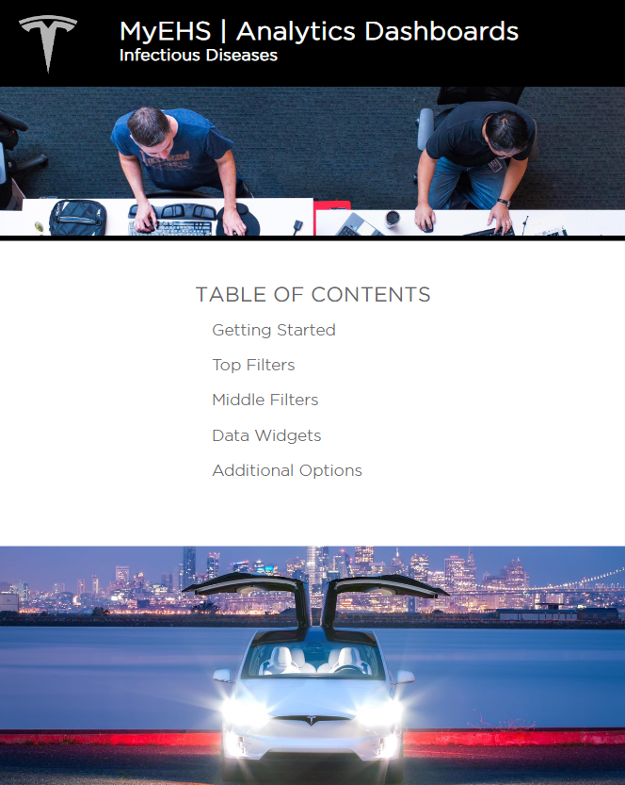
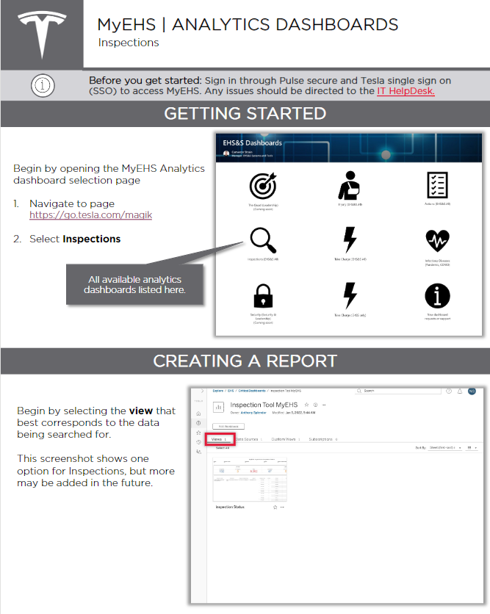
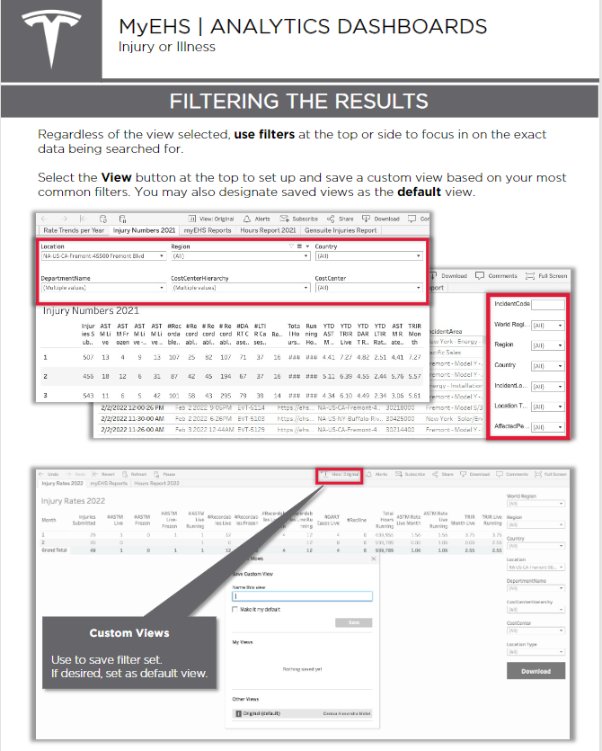
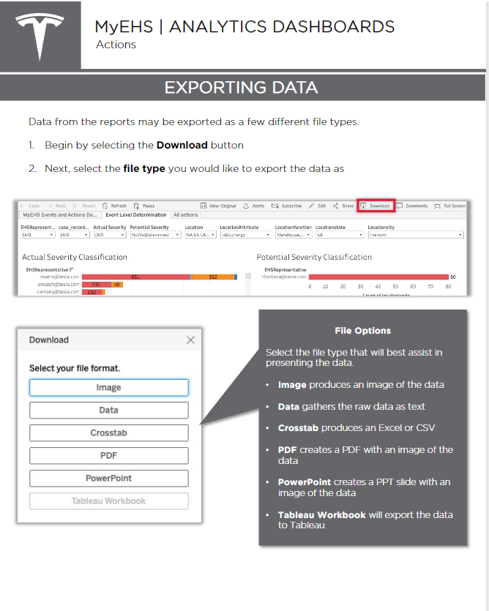
Quick Reference Guides (QRGs)
What: Instructions on how to find, view, and filter data from EHSS dashboards to create reports & draw insights
Where: go.tesla.com/qrg
Questions/Edits/Requests: MyEHS@tesla.com

Slide 17
Need Help or Have a Suggestion?
MyEHS@tesla.com
E-Ticketing allows us to track requests and better manage them.
Another medium of communication with S&T
Office Hours coming in March!

Slide 18
Q&A

Slide 19
Call to Action
How can data help you drive informed action?
Reach and Empower Stakeholders
Do the basics right
Reduce Risk

Slide 20
Closing Remarks
Notes:
Grateful for the patience and partnership of the EHSS group

